Slide 1
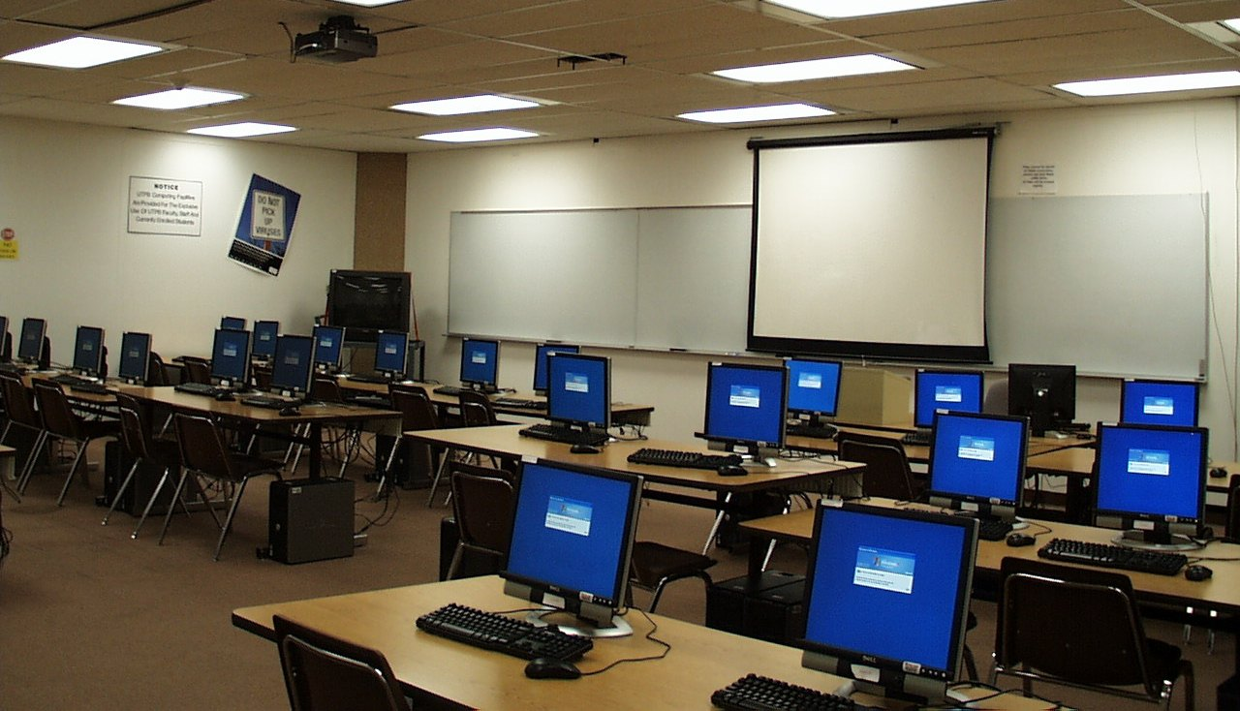



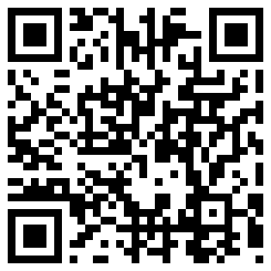
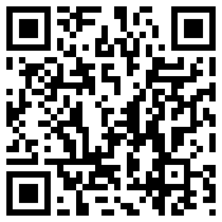
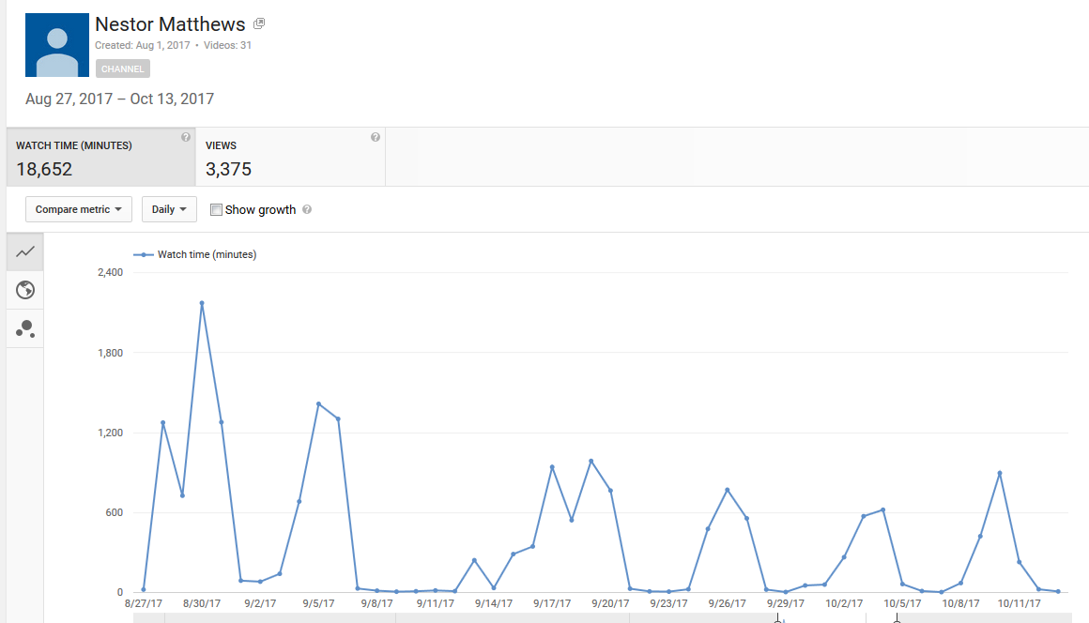

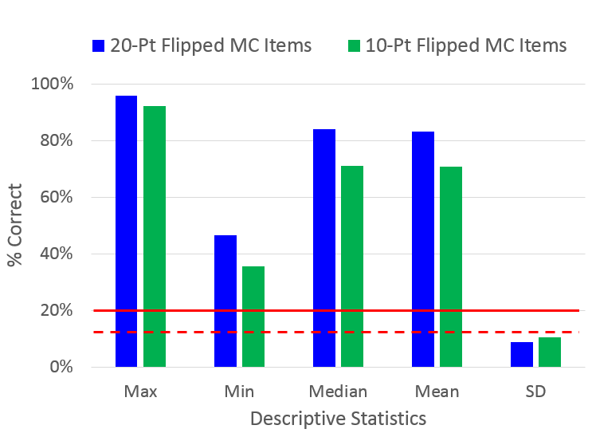
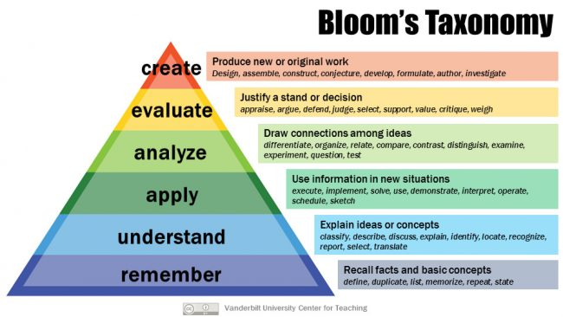
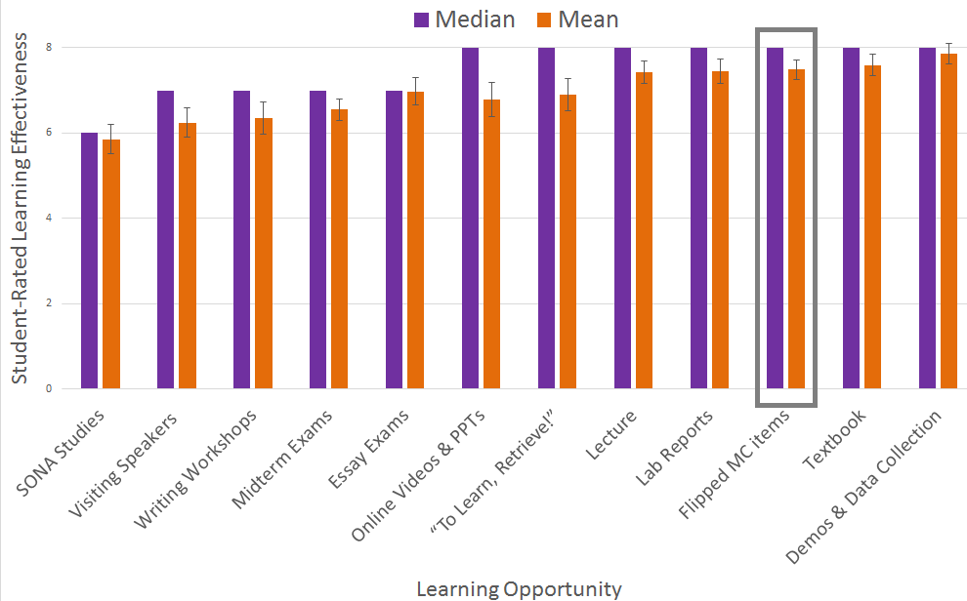
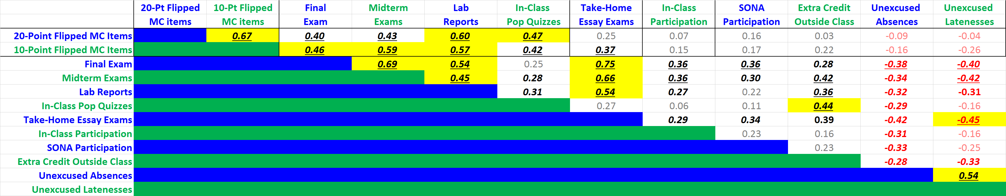
Flippin’ Intro Psyc
Nestor Matthews, Department of Psychology, Denison University
Videos
Open Access Intro Psyc Videos & PPTs: http://personal.denison.edu/~matthewsn/intropsyc
Poster
Poster: http://personal.denison.edu/~matthewsn/nitop2018
Introduction
Results
A flipped classroom requires students to complete instructional content outside of class,
so that class time can be used for active learning rather than for lecturing. The current project
entailed flipping two sections (n=54) of Denison University’s Introduction to Psychology course
during the fall 2017 semester. The following pedagogical goals motivated this project.
Goals
View-Time Peaks Match Test & Assignment Dates
1. Increase student engagement with material outside the classroom.
2. Broaden in-class participation.
3. Distribute students’ practice across time and contexts.
4. More fully understand students’ prior knowledge.
5. Level the playing field in students’ preparedness for each class period.
Cultivate students’ self-directed learning.
Generate Intro Psyc learning and teaching resources, freely available worldwide.
Chance
Goals 1-6 align with empirically supported learning principles.
Make it Stick: Brown, Roediger & McDaniel, 2014;
How Learning Works: 7 Research-Based Principles for Smart Teaching: Ambrose et al., 2010;
Teaching Students How to Learn: McGuire & McGuire, 2015;
Relearn Faster & Retain Longer: Along with Practice, Sleep Makes Perfect: Mazza et al., 2016;
The Critical Importance of Retrieval and Spacing for Learning: Soderstrom, Kerr & Bjork, 2016.
Goal 7 renders psychological science more accessible, affordable, and inclusive.
Bloom’s Lower Levels
The Full Range of Bloom’s Levels
“Full Bloom”
& ESWE
Extraversion
Conscientiousness
Methods
On the evening before each class period, students completed a low-stakes online quiz
requiring multiple-choice (MC) responses to an Introductory Psychology video or reading. Automated feedback became available to students at 6 AM the following morning. Delaying the feedback until after students (presumably) slept temporally distributed the students’ engagement with the material, as recommended in “Make it Stick” (Brown, Roediger & McDaniels, 2014). The timing also exploited the sleep-related consolidation described in “Relearn Faster and Retain Longer: Along with Practice, Sleep Makes Perfect” (Mazza et al., 2016). Learning outcomes were evaluated by rank-correlations between online preparatory homework performance (“Flipped MC items”) and grade-related outcome variables.
n.s.= Faded: p < 0.05 = Bold & Italic (r >= 0.268): p < 0.01 = Bold & Italic & Underlined (r >= 0.349): p < 0.001 = Bold & Italic & Underlined & Yellow Fill (r >= 0.435)
Bottom Line
(1) Performance on “Flipped” MC items correlated significantly with performance on assignments that tapped higher levels in Bloom’s taxonomy. The correlation was largely independent of personality factors (extraversion and conscientiousness), and students’ mastery of Edited Standard Written English (ESWE). (2) Subjectively, “Flipped” MC items increased and broadened students’ in-class participation. (3) The project generated numerous open access Intro Psyc videos and PPT’s to promote psychological science. Please Share!

